Slide 1
SoftHier Progress Update
Chi Zhang chizhang@iis.ee.ethz.ch

Slide 2
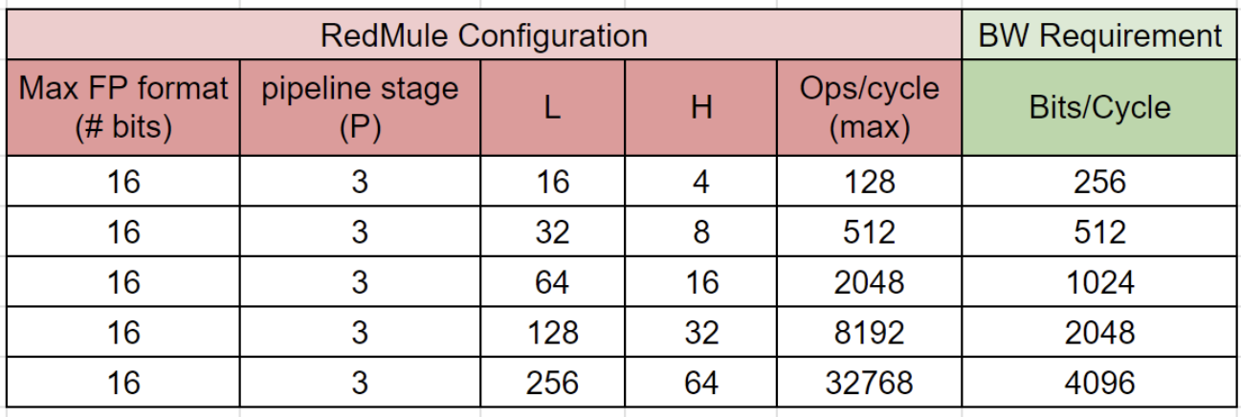
Latency=4
Rephase Cluster & RedMule exploration
Instead of seeking for best effective FLOPs/L1
We still need to take account of RedMule’s area and utilization
We need to make sure
RedMule should reach 90% utilization
Seeking for minimal L1 size to meet (1)
Sync with Yvan (RedMule author) and double check RedMule modeling details
H
CE Pipeline
Stage = 3
CE
CE
CE
CE
Y/Z
Buffer
X
X
X
X
CE
CE
CE
CE
X
X
X
X
CE
CE
CE
CE
X
X
X
X
CE
CE
CE
CE
L
X
X
X
X
CE
CE
CE
CE
X
X
X
X
CE
CE
CE
CE
X
X
X
X
CE
CE
CE
CE
X
X
X
X
CE
CE
CE
CE
X
X
X
X
W Buffer

Slide 3
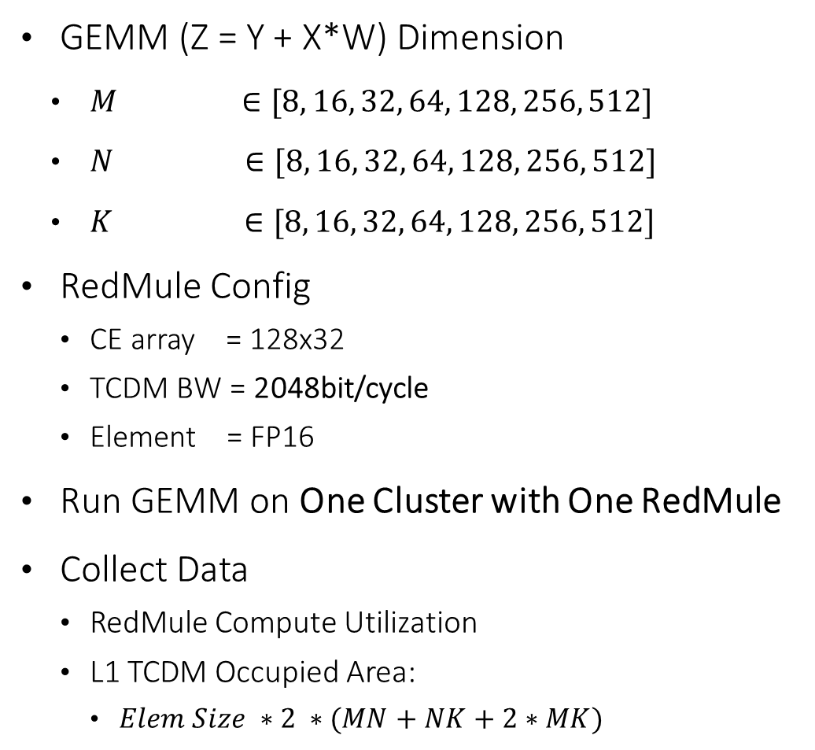
Minimal L1 Size in Cluster for ~90% RedMule Uti
GEMM (Z = Y + X*W) Dimension
$M ∈[8, 16, 32, 64, 128, 256, 512]$
$N ∈[8, 16, 32, 64, 128, 256, 512]$
$K ∈[8, 16, 32, 64, 128, 256, 512]$
RedMule Config
CE array = 128x32
TCDM BW = 2048bit/cycle
Element = FP16
Run GEMM on One Cluster with One RedMule
Collect Data
RedMule Compute Utilization
L1 TCDM Occupied Area:
$Elem Size ∗2 ∗(MN+NK+2∗MK)$
N
K
K
X
W
Y/Z
M
M
N
256-256-256

Slide 4
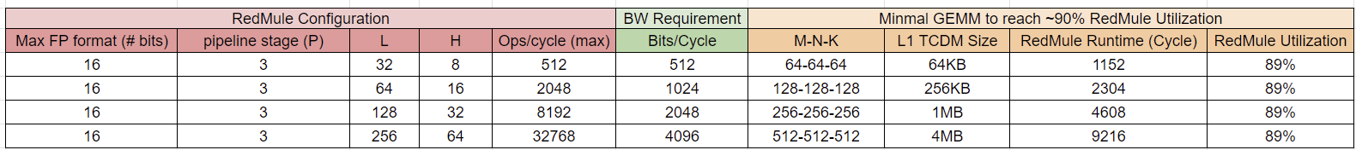
Minimal GEMM in Cluster for ~90% RedMule Uti

Slide 5
Compare GEMM Inter-Cluster Scheduling Schemes
On-Chip Shuffling
Systolic like Streaming
HBM
HBM
I₀₃
I₁₂
I₂₁
I₃₀
I₀₃
I₁₂
I₂₁
I₃₀
I₀₃
I₁₂
I₂₁
I₃₀
I₀₃
I₁₂
I₂₁
I₃₀
W₀₀
W₁₁
W₂₂
W₃₃
I₀₃
I₁₂
I₂₁
I₃₀
Cluster₀₀
（2）
Cluster₀₀
Cluster₀₁
Cluster₀₂
Cluster₀₃
I₀₀
I₀₁
Cluster₀₁
Cluster₀₂
I₀₂
I₀₃
Cluster₀₃
I₀₂
I₁₁
I₂₀
W₃₀
W₃₀
（1）
W₃₀
W₃₀
W₃₀
W₂₀
W₁₀
W₀₀
I₀₀
W₀₀
W₁₁
W₂₂
W₃₃
Cluster₁₀
Cluster₁₀
Cluster₁₁
Cluster₁₂
Cluster₁₃
I₁₃
I₁₀
Cluster₁₁
Cluster₁₂
I₁₁
Cluster₁₃
I₁₂
I₀₁
I₁₀
W₂₁
W₂₁
W₂₁
W₂₁
W₂₁
W₁₁
W₀₁
I₁₃
HBM
W₃₀
W₀₁
W₁₂
W₂₃
HBM
I₂₂
Cluster₂₀
Cluster₂₁
Cluster₂₂
Cluster₂₃
Cluster₂₀
I₂₃
Cluster₂₁
Cluster₂₂
I₂₀
Cluster₂₃
I₂₁
I₀₀
W₁₂
W₁₂
W₁₂
W₁₂
W₁₂
W₀₂
I₂₂
W₂₀
W₃₁
W₀₂
W₁₃
I₃₁
Cluster₃₀
Cluster₃₁
Cluster₃₂
Cluster₃₃
Cluster₃₀
Cluster₃₁
I₃₂
Cluster₃₂
Cluster₃₃
I₃₃
I₃₀
W₀₃
W₀₃
W₀₃
W₀₃
W₀₃
I₃₁
W₁₀
W₂₁
W₃₂
W₀₃

Slide 6
Compare GEMM Inter-Cluster Scheduling Schemes
On-Chip Shuffling – Double Buffer

Slide 7
Compare GEMM Inter-Cluster Scheduling Schemes
On-Chip Shuffling – Double Buffer
On-Chip Shuffling – Triple Buffer

Slide 8
Compare GEMM Inter-Cluster Scheduling Schemes
On-Chip Shuffling – Double Buffer
On-Chip Shuffling – Triple Buffer
Systolic like Streaming – Double Buffer

Slide 9
Compare GEMM Inter-Cluster Scheduling Schemes
Benchmark GEMM
16384 x16384 x16384
GEMM Elem Size = FP16
SoftHier System Configuration
Cluster
RedMule 128x32
1MB SRAM per cluster
Each cluster compute tile 128x128
8x8 Clusters + 32 HBM2E channels
Result
Systolic streaming is better
Require narrower NoC Link DataWidth

Slide 10
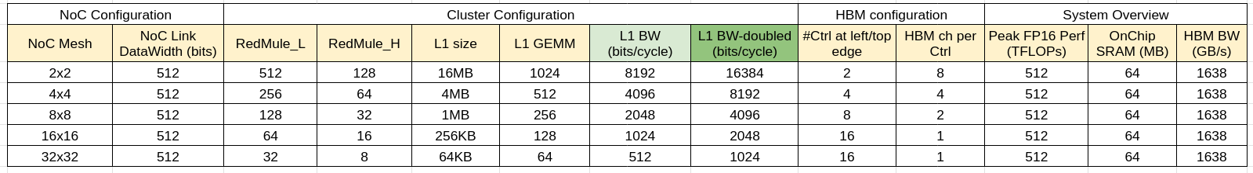
Many Clusters with small RedMule vs. Few Clusters with big RedMule
C
C
C
C
RM
RM
RM
RM
C
RM
C
RM
C
RM
C
RM
C
RM
C
RM
C
RM
C
RM
C
C
C
C
C
C
C
C
RM
RM
RM
RM
RM
RM
RM
RM
C
C
C
C
C
C
C
C
C
C
C
C
RM
RM
RM
RM
RM
RM
RM
RM
RM
RM
RM
RM
C
C
C
C
C
C
C
C
RM
RM
RM
RM
RM
RM
RM
RM
C
RM
C
RM
C
RM
C
RM
C
RM
C
RM
C
RM
C
C
C
C
C
RM
RM
RM
RM
RM
C
RM
C
RM
C
RM
C
RM
C
RM
C
RM
C
RM
C
RM
C
RM
C
RM
C
RM
C
RM
C
RM
C
RM
C
RM
C
C
C
C
C
RM
RM
RM
RM
RM
C
RM
C
RM
C
RM
C
RM
C
RM
C
RM
C
RM
C
RM

Slide 11
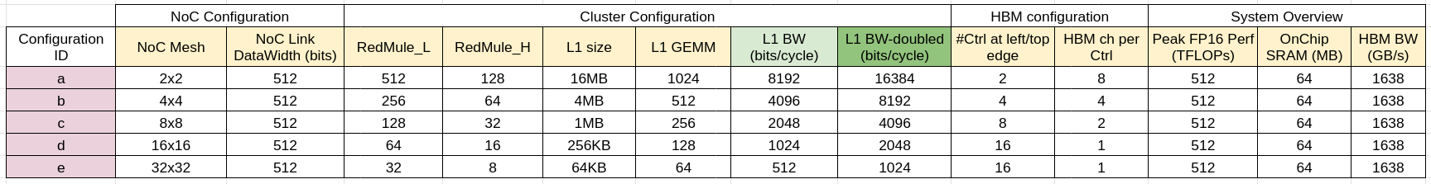
Many Clusters with small RedMule vs. Few Clusters with big RedMule
Benchmark GEMM
16384 x16384 x16384
GEMM Elem Size = FP16
Systolic-like inter-cluster tile stream
Result
Few Clusters with Big RedMule
Limited by NoC BW (if it can not scale)
Other potential limitations
RedMule may not scale
L1 TCDM BW may not scale
Less flexible for application with small GEMM
Many Clusters with small RedMule
Small L1-> Narrow GEMM steps -> More Sync needed
Many Cluster -> Each Sync costs more time
NoC BW-bound
Sync-bound

Slide 12
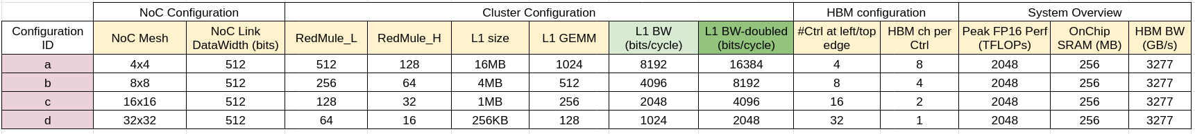
Many Clusters with small RedMule vs. Few Clusters with big RedMule
SoftHier_v1
SoftHier_v2
512 TFLOPs (FP16)
64 MB SRAM
64 Clusters
2048 TFLOPs (FP16)
256 MB SRAM
256 Clusters

Slide 13
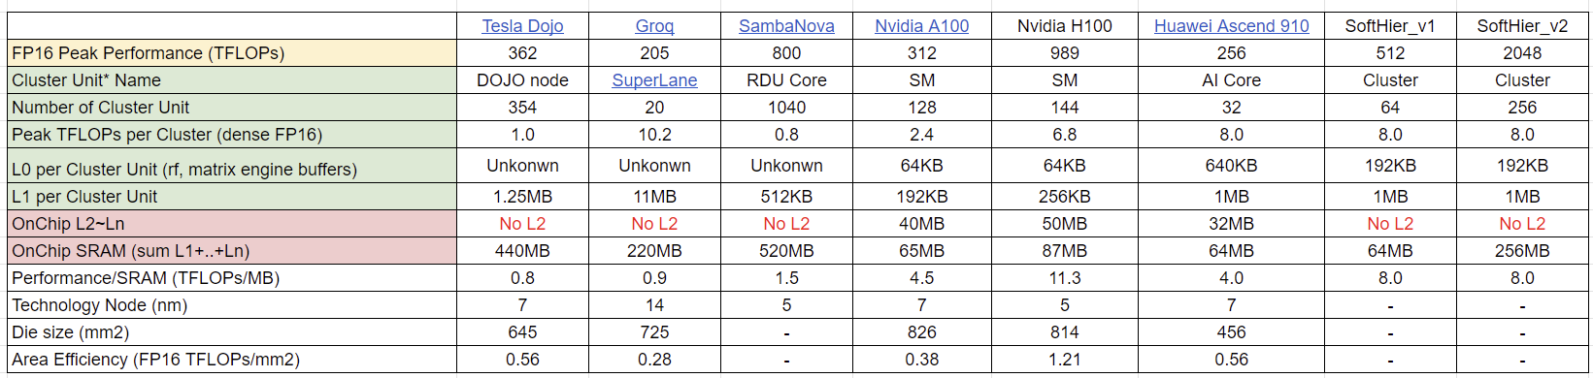
SoA Comparison
Cluster Unit* : the smallest hierarchy level that couples matrix engines and local tightly-coupled memory

Slide 14
Next Step
Currently we only have global cluster synchronization, we need to add support for subset cluster synchronization scheme
Mapping a whole LLama3 layer (with various sequence length and batch size) on SoftHier_v1/v2 system

Slide 15
Other Progress update
Luca C. was taking holidays
Thomas is currently busy with Occamy Journal paper

